Slide 1


Inventory Management System
Final Project
Submission By: Aarush Bhardwaj
abhardw3@kent.edu, 811126136

Slide 2



Evaluating overall efficiency of Inventory Management System by simulating it’s current working of 2 departments: 1. Demand 2. Production

Slide 3


The Project aims to: - Model the working of 2 departments - Find any loop holes or problem areas - Recommend suggestions to fix it.

Slide 4
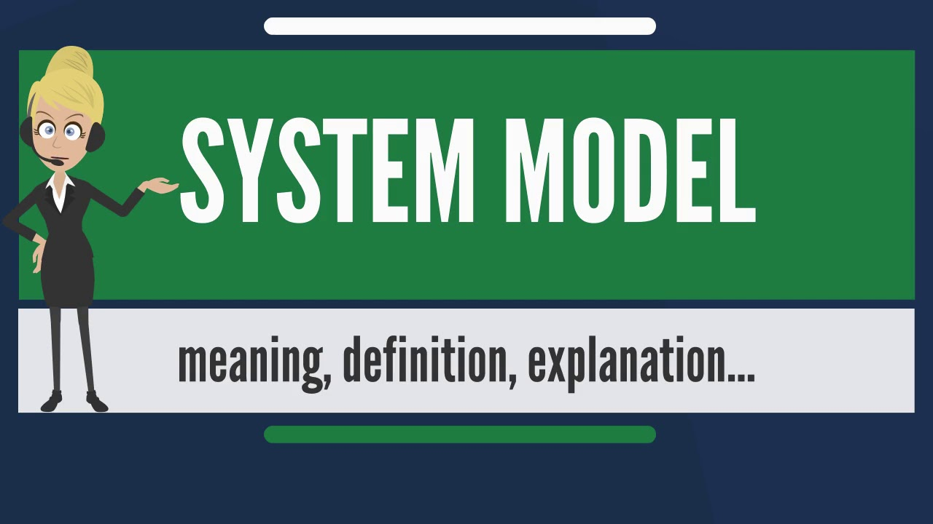
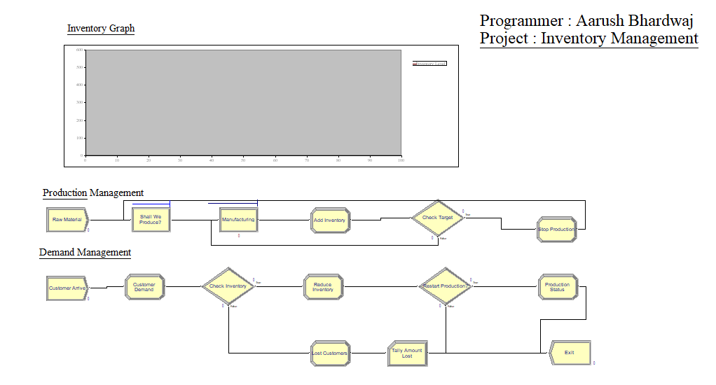
The model Consists of 2 parts: 1. Demand Management: - In this the customer enters, places order and leaves the system either after purchasing or without it. - In addition to servicing customers, it also triggers the production of new products. 2. Production Management: - This department starts/stops manufacturing as and when required.

Slide 5

- Good Service time. . - Need of better production criteria and less machine idle time (Changing min value of inventory) - Less customer turn around - Addition of new resources.
Pros:
Cons:

Slide 6

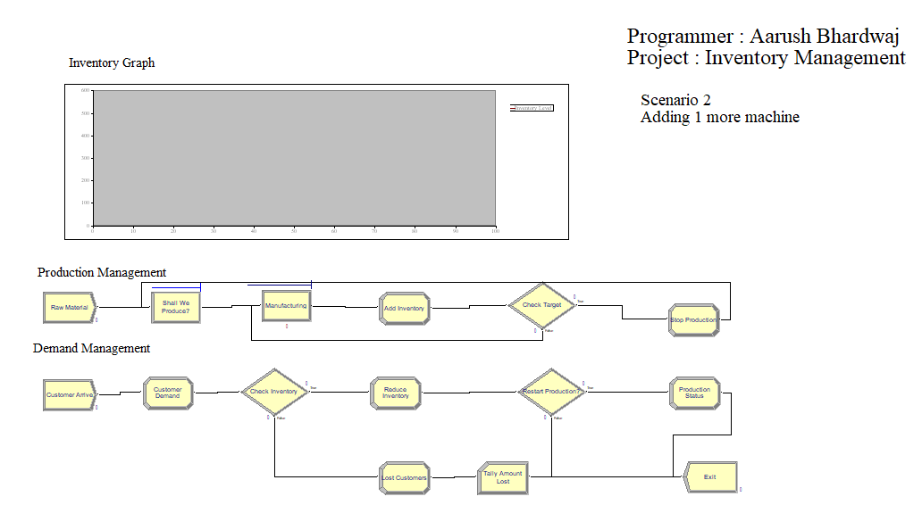
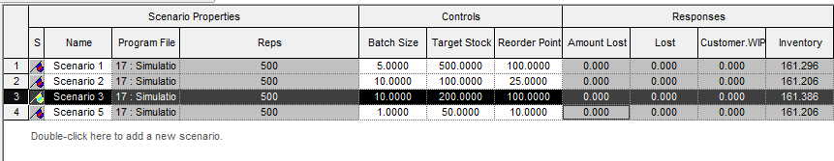
Scenario 1: Finding optimal inventory value using Process Analyser.
Scenario 2: Adding another resource to existing model (Machine 2).

Slide 7

No scenario gives the satisfactory result. Addition of new machine does not make much of difference to the overall model performance. Also the existing inventory value is the optimal value and increasing it would actually increase customer turn around, slightly.

Slide 8


